Slide 1


5
Making
Decisions
C# Programming: From Problem Analysis to Program Design
3rd Edition

Slide 2
Chapter Outline
Equality & Relational Operators
Boolean Expressions
Logical Operators
if and if-else Statements
switch Statement

Slide 3
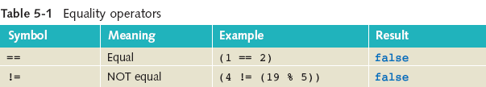
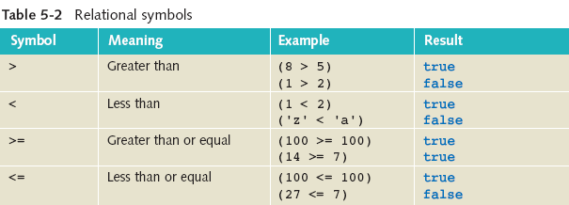
1. Equality & Relational Operators

Slide 4
2. Boolean Expressions
Boolean variables
Example
bool moreData = true;
Boolean expressions
Examples
(score >= 50)
(temperature < 20)

Slide 5
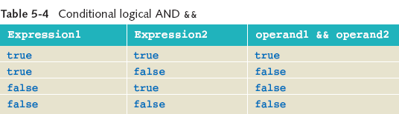
3. Logical Operators

Slide 6
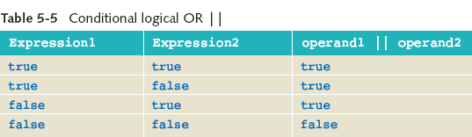
Logical Operators

Slide 7
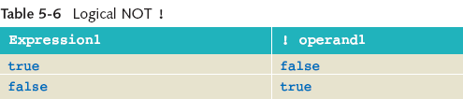
Logical Operators

Slide 8
Short-Circuit Evaluation
Short-circuiting logical operators for && and ||
|| expressions – if the first operand evaluates as true, no need to evaluate the second operand
&& expressions – if the first operand evaluates as false, no need to evaluate second operand

Slide 9
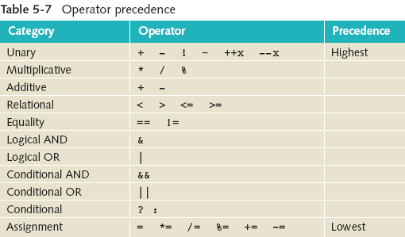

Operator Precedence

Slide 10
4. if and if-else Statements
if (expression)
{
statement(s);
}

Slide 11
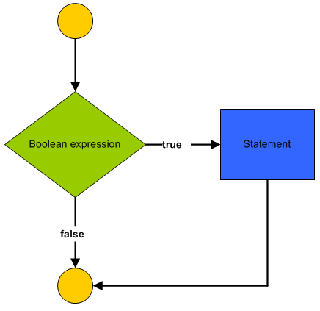
if and if-else Statements

Slide 12
if and if-else Statements
if (expression)
{
statement(s);
}
else
{
statement(s);
}

Slide 13
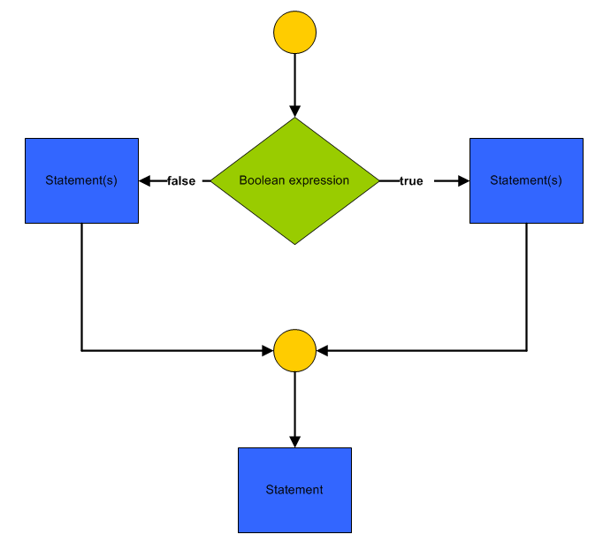
if and if-else Statements

Slide 14
Nested if…else Statements
bool hourlyEmployee;
double hours, bonus;
int yearsEmployed;
. . .
if (hourlyEmployee)
if (hours > 40)
bonus = 500;
else
bonus = 100;
else
if (yearsEmployed > 10)
bonus = 300;
else
bonus = 200;
Bonus is assigned 100 when hourlyEmployee == true AND hours is less than or equal to 40

Slide 15
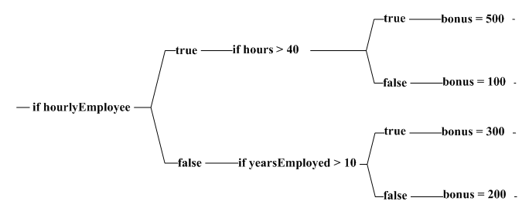
Bonus Decision Tree

Slide 16
Matching Else and If Clauses
if (aValue > 10)
if (bValue == 0)
amount = 5;
else
if (cValue > 100)
if (dValue > 100)
amount = 10;
else
amount = 15;
else
amount = 20;
else
if (eValue == 0)
amount = 25;

Slide 17
5. switch Statement
Integral or string type
switch (expression)
{
case value1: statement(s);
break;
. . .
case valueN: statement(s);
break;
[default: statement(s);
break;]
}

Slide 18
switch Statement Example
switch (cityCode)
{
case "KL":
Console.Write("Kuala Lumpur");
break;
case "PJ":
Console.Write("Petaling Jaya");
break;
default:
Console.Write("Unknown");
break;
}

